Slide 1


Software Development Skills Bootcamp
JavaScript- 1
Copyright © e-Careers. All Rights Reserved

Slide 2


Introduction to JavaScript
JavaScript was initially created to “make web pages alive”.
They can be written right in a web page’s HTML and run automatically as the page loads.
Today, JavaScript can execute not only in the browser, but also on the server, or actually on any device that has a special program called the JavaScript engine.

Slide 3
Introduction to JavaScript
The browser has an embedded engine sometimes called a “JavaScript virtual machine”.
V8 – in Chrome
SpiderMonkey – in Firefox.
Chakra - IE

Slide 4
How JavaScript internally works?
Here’s a general overview of how a JS engine works:
JavaScript Source Code
Parser
Abstract Syntax Tree (AST)
Interpreter
Compiler

Slide 5
What can in-browser JavaScript do?
In-browser JavaScript can do everything related to webpage manipulation, interaction with the user, and the webserver.
For instance, in-browser JavaScript is able to:-
Add new HTML to the page, change the existing content, modify styles.
React to user actions, run on mouse clicks, pointer movements, key presses.
Get and set cookies, ask questions to the visitor, show messages.
Remember the data on the client-side (“local storage”).

Slide 6
Running first JavaScript program
JavaScript programs can be inserted almost anywhere into an HTML document using the <script> tag.
<!DOCTYPE HTML>
<html>
<body>
<p>Before the script...</p>
<script>
alert( 'Hello, world!' );
</script>
<p>...After the script.</p>
</body>
</html>

Slide 7
Running first JavaScript program
External Scripts:-
Script files are attached to HTML with the src attribute:-
<script src="/path/to/script.js"></script>
We can give a full URL as well. For instance:-
<script src="https://cdnjs.cloudflare.com/ajax/libs/lodash.js/4.17.11/lodash.js"></script>

Slide 8
Running first JavaScript program
As a rule, only the simplest scripts are put into HTML. More complex ones reside in separate files.
The benefit of a separate file is that the browser will download it and store it in its cache.
Other pages that reference the same script will take it from the cache instead of downloading it, so the file is actually downloaded only once.
That reduces traffic and makes pages faster.

Slide 9
Running first JavaScript program
A single <script> tag can’t have both the src attribute and code inside:-
<script src="file.js">
alert(1); // the content is ignored, because src is set
</script>

Slide 10
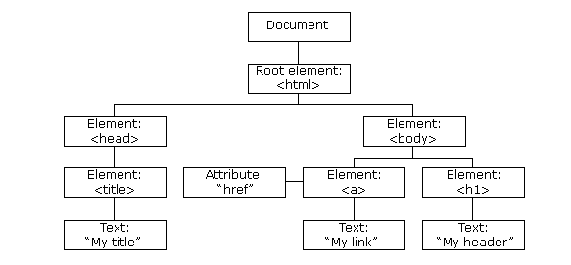
Understanding the DOM
The HTML DOM Tree of Objects

Slide 11
Understanding the DOM
The Document Object Model is a representation of the HTML and CSS structure and style.
Basically, the browser that you use to view a website creates a representation of the code that can be accessed by other web-scripting language as objects.
The source of a website will not change and will never be affected by client-side JavaScript. However changes on the DOM can be performed and this allows a programming language to manipulate the content, structure, and style of a website.

Slide 12
JavaScript Events
HTML events are "things" that happen to HTML elements.
When JavaScript is used in HTML pages, JavaScript can "react" on these events.
Example:-
Event | Description
onchange | An HTML element has been changed
onclick | User clicks and HTML element
onmouseover | The user moves the mouse over an HTML element
onmouseout | The user moves the mouse away from an HTML element
onload | The browser has finished loading the page

Slide 13
JavaScript Events
<!DOCTYPE html>
<html>
<body>
<h2>JavaScript to Change HTML</h2>
<p id="p1">Hello World!</p>
<script>
function changeText(){
document.getElementById("p1").innerHTML = "New text!";
}
</script>
<p>The paragraph above was changed by a script.</p>
<input type = "button" value ="Change" onclick="changeText()"/>
</body>
</html>

Slide 14
querySelector():-
The querySelector() method returns the first element that matches a specified CSS selector(s) in the document.
The querySelectorAll() method returns all elements in the document that matches a specified CSS selector(s)
var x = document.querySelectorAll("p"); x[0].style.backgroundColor = "red";

Slide 15
JavaScript Variables
A variable is a “named storage” for data. We can use variables to store different kind of data.
To create a variable in JavaScript, use the ‘let’ or ‘var’ keyword.
Variable Declaration Vs Variable Definition:
let message; // This statement only declares the variable
message = “hello” // this is where we are defining the variable and assigning a value to it
let message = “hello” // Declaration and definition happening simultaneously.

Slide 16
JavaScript Variables
let user = 'John', age = 25, message = 'Hello’; //multiple variables in single line
JavaScript is a dynamically typed language → meaning that there exist data types, but variables are not bound to any of them.
Different ways to declare a variable in JavaScript:
let :- Introduced in ES6 with block scope, redeclaration intolerance etc.
const :- Introduced in ES6 to declare constant values.
Var :- Old way to declare a variable without block scope etc.

Slide 17
JavaScript Variables
Block Scope
if (true) {
var test = true; // use "var" instead of "let"
}
alert(test); // true, the variable lives after if
if (true) {
let test = true; // use "let“
}
alert(test); // ReferenceError: test is not defined

Slide 18
JavaScript Variables
Redeclaration
var user = "Pete";
var user = "John"; // Redeclared
alert(user); // John
let user = "Pete";
let user = "John"; ; // SyntaxError: 'user' has already been declared

Slide 19
JavaScript Variables
Variable Naming Rules:
There are two limitations on variable names in JavaScript:
The name must contain only letters, digits, or the symbols $ and _.
The first character must not be a digit.
let test123; // valid name
let 1a; // cannot start with a digit

Slide 20
JavaScript Variables
For example: let, class, return, and function are reserved.
Variables named apple and AppLE are two different variables.
There is a list of reserved words, which cannot be used as variable names because they are used by the language itself.
For example: let, class, return, and function are reserved.
Constants should be named in uppercase:-
const COLOR_ORANGE = "#FF7F00";
Variables should always be named right – They should reflect what they represent

Slide 21
JavaScript Data Types
There are eight basic data types in JavaScript.
Number
The number type represents both integer and floating point numbers.
let n = 123;
n = 12.345;
Besides regular numbers, there are so-called “special numeric values” which also belong to this data type: Infinity, -Infinity and NaN.
alert( 1 / 0 ); // Infinity
alert( "not a number" / 2 + 5 ); // NaN

Slide 22
JavaScript Data Types
String
A string in JavaScript must be surrounded by quotes. Either double quotes or single quotes.
let str = "Hello";
let str2 = 'Single quotes are ok too';
In JavaScript, there are 3 types of quotes.
Double quotes: "Hello".
Single quotes: 'Hello'.
Backticks: `Hello`.

Slide 23
JavaScript Data Types
String
Backticks are “extended functionality” quotes. They allow us to embed variables and expressions into a string by wrapping them in ${…},
For example:-
let name = "John"; // embed a variable
alert( `Hello, ${name}!` ); // Hello, John!

Slide 24
JavaScript Data Types
Boolean
The boolean type has only two values: true and false.
Null
It’s just a special value which represents “nothing”, “empty” or “value unknown”.
The code below states that age is unknown.
let age = null;
Undefined
If a variable is declared, but not assigned, then its value is undefined:
let age;
alert(age); // shows "undefined"

Slide 25
JavaScript Data Types
typeof operator
The typeof operator returns the type of the argument. It’s useful when we want to process values of different types differently or just want to do a quick check.
It supports two forms of syntax:-
As an operator: typeof x.
As a function: typeof(x).

Slide 26
Interaction: alert, prompt, confirm
alert
This one we’ve seen already. It shows a message and waits for the user to press “OK”.
alert("Hello");
prompt
The function prompt accepts two arguments:
result = prompt(title, [default]);
The square brackets around default in the syntax above denote that the parameter is optional, not required. Some IE versions do require it.
It shows a modal window with a text message, an input field for the visitor, and the buttons OK/Cancel.

Slide 27
Interaction: alert, prompt, confirm
confirm
The confirm() method displays a dialog box with a message, an OK button, and a Cancel button.
The confirm() method returns true if the user clicked "OK", otherwise false
<script>
function myFunction() {
let text = "Press a button!\nEither OK or Cancel.";
if (confirm(text) == true) {
text = "You pressed OK!";
} else {
text = "You canceled!";
}
document.getElementById("demo").innerHTML = text;
}

Slide 28
Type Conversion
Most of the time, operators and functions automatically convert the values given to them to the right type.
There are also cases when we need to explicitly convert a value to the expected type.
String Conversion:-
String conversion happens when we need the string form of a value.
let value = true;
alert(typeof value); // boolean
value = String(value); // now value is a string "true" alert(typeof value); // string

Slide 29
Type Conversion
Numeric Conversion:-
Numeric conversion happens in mathematical functions and expressions automatically.
For example, when division / is applied to non-numbers:
alert( "6" / "2" ); // 3, strings are converted to numbers
Explicit conversion is usually required when we read a value from a string-based source like a text form but expect a number to be entered.

Slide 30
Type Conversion
We can use the Number(value) function to explicitly convert a value to a number:
let str = "123";
let num = Number(str); // becomes a number 123
Boolean Conversion:-
The conversion rule:-
Values that are intuitively “empty”, like 0, an empty string, null, undefined, and NaN, become false.
Other values become true.
alert( Boolean(1) ); // true
alert( Boolean(0) ); // false
alert( Boolean("hello") ); // true
alert( Boolean("") ); // false

Slide 31
Operators
In JavaScript, an operator is a special symbol used to perform operations on operands (values and variables).
For example,
2 + 3; // 5
Types of operators:
Assignment Operators
Arithmetic Operators
Comparison Operators
Logical Operators
Bitwise Operators
String Operators
Other Operators

Slide 32
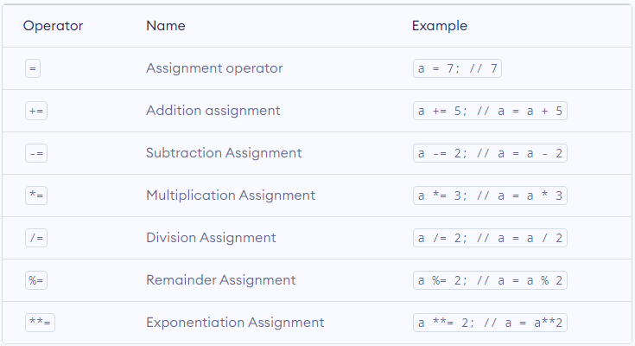
Operators
Assignment operators:-

Slide 33
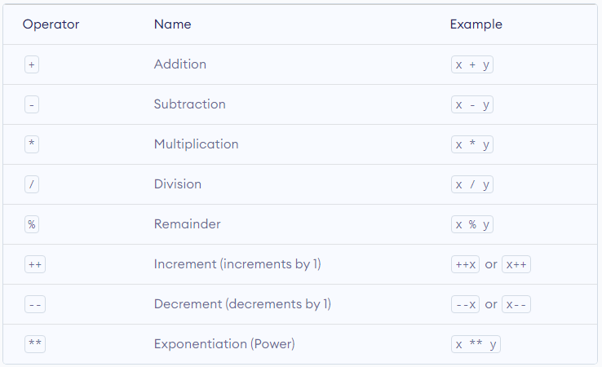
Operators
Arithmetic operators:-

Slide 34
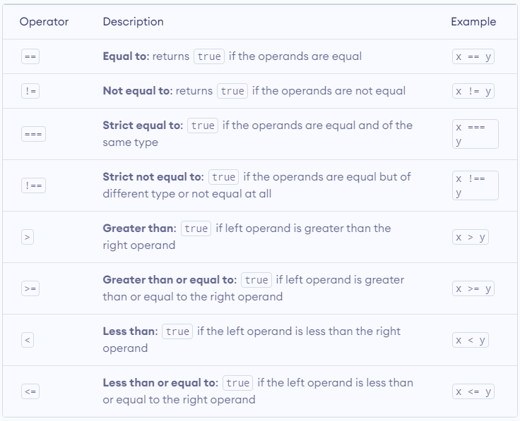
Operators
Comparison operators:-

Slide 35
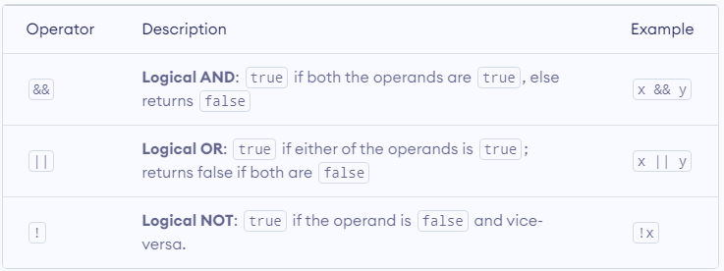
Operators
Logical operators:-

Slide 36
JavaScript Program Flow
If else statement:-
The if statement executes a statement or block of code if a condition is satisfied.
if(condition)
statement;
The condition can be any valid expression. In general, the condition evaluates to a Boolean value, either true or false.
In case the condition evaluates to a non-Boolean value, JavaScript implicitly converts its result into a Boolean value by calling the Boolean() function.
If the condition evaluates to true, the statement is executed. Otherwise, the control is passed to the next statement that follows the if statement.

Slide 37
JavaScript Program Flow
If else statement:-
if( condition ) {
// statement (when condition evaluates to true)
}
else {
// statement (when condition evaluates to false) }
You can chain the if else statements:-
if (condition_1) {
// statments
}
else if (condition_2) {
// statments
}
else {
// statments
}

Slide 38
JavaScript Program Flow
if else shortcut: conditional operator:-
condition ? expression_1 : expression_2
let allowRegister = age > 18 ? true : false;

Slide 39
JavaScript Program Flow
Switch case statement:-
The switch statement is a flow-control statement that is similar to the if else statement. You use the switch statement to control the complex conditional operations.
switch (expression) {
case value_1:
statement_1;
break;
case value_2:
statement_2;
break;
case value_3:
statement_3;
break;
default:
default_statement;
}

Slide 40
JavaScript Program Flow
While Loop:-
The JavaScript while statement creates a loop that executes a block of code as long as the test condition evaluates to true.
let count = 1; // Initialization
while (count < 10) { // Condition
console.log(count);
count +=2; // Increment
}

Slide 41
JavaScript Program Flow
Do-While Loop:-
The do-while loop statement creates a loop that executes a block of code until a test condition evaluates to false.
let count = 0; // Initialization
do {
count++; // Increment
console.log('count is:' + count);
} while (count < 10); // Condition

Slide 42
JavaScript Program Flow
Loop:-
The JavaScript for loop statement allows you to create a loop with three optional expressions.
Guess the output:-
for (var counter = 1; counter < 5; counter++) { console.log('Inside the loop:' + counter);
} console.log('Outside the loop:' + counter);
for (let counter = 1; counter < 5; counter++) { console.log('Inside the loop:' + counter);
} console.log('Outside the loop:' + counter);

Slide 43
JavaScript Program Flow
Loop:-
var j = 1;
for (; j < 10; j += 2) { // without initialization.
console.log(j);
}
for (let j = 1;; j += 2) { // without condition.
console.log(j);
if (j > 10) {
break;
}
}

Slide 44
JavaScript Program Flow
Loop:-
let j = 1;
for (;;) { // without any expression
if (j > 10)
break;
console.log(j);
j += 2;
}

Slide 45
JavaScript Program Flow
Break Statement:-
The break statement terminates the loop immediately and passes control over the next statement after the loop.
for (var i = 1; i < 10; i++) {
if (i % 3 == 0) {
break;
}
}
console.log(i);

Slide 46
JavaScript Program Flow
Break Statement:-
let iterations = 0;
top:
for (let i = 0; i < 5; i++) {
for (let j = 0; j < 5; j++) { iterations++;
if (i === 2 && j === 2) {
break top;
}
}
}
console.log(iterations);

Slide 47
JavaScript Program Flow
Continue Statement:-
The continue statement skips the current iteration of a loop and immediately jumps to the next one.
let s = 'This is a JavaScript continue statement demo.';
let counter = 0;
for (let i = 0; i < s.length; i++) {
if (s.charAt(i) != 's') {
continue;
}
counter++;
}
console.log('The number of s found in the string is ' + counter);

Slide 48
JavaScript Program Flow
Continue Statement:-
// continue with a label
outer: for (let i = 1; i <= 3; i++) {
for (let j = 1; j <= 3; j++) {
if ((i == 2) && (j == 2)) {
console.log('continue to outer');
continue outer;
}
console.log("[i:" + i + ",j:" + j + "]");
}
}

Slide 49
JavaScript Strings
JavaScript strings are primitive values.
JavaScript strings are also immutable.
It means that if you process a string, you will always get a new string. The original string doesn’t change.
let str = 'Hi';
let greeting = "Hello";
let name = 'John';
let message = `Hello ${name}`;
console.log(message);

Slide 50
JavaScript Strings
Getting the length of the String:-
let str = "Good Morning!";
console.log(str.length);
Accessing characters:-
let str = "Hello";
console.log(str[0]); //
How to access last character of any String ?

Slide 51
JavaScript Strings
Concateneting Strings:-
let name = 'John';
let str = 'Hello ' + name;
console.log(str); // "Hello John"
Converting values to String:-
To convert a non-string value to a string, you use one of the following:
String(n);
” + n
n.toString()

Slide 52
JavaScript Strings
Comparing Strings:-
To compare two strings, you use the operator >, >=, <, <=, and == operators.
To see whether a string is greater than another, JavaScript uses the so-called “dictionary” or “lexicographical” order.
In other words, strings are compared letter-by-letter.
alert( 'Z' > 'A' ); // true
alert( 'Glow' > 'Glee' ); // true
alert( 'Bee' > 'Be' ); // true

Slide 53
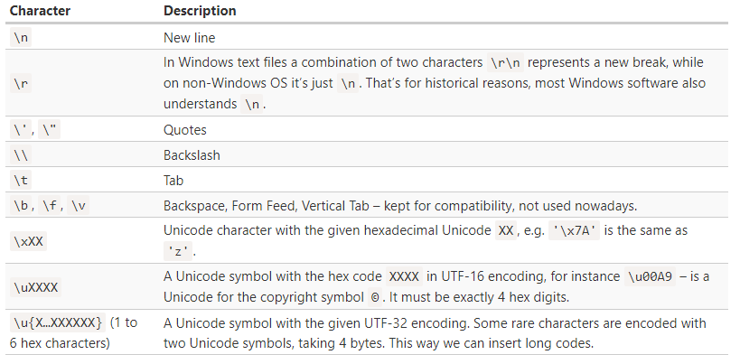
JavaScript Strings
Special Characters:-

Slide 54
JavaScript Assignment #1

Slide 55
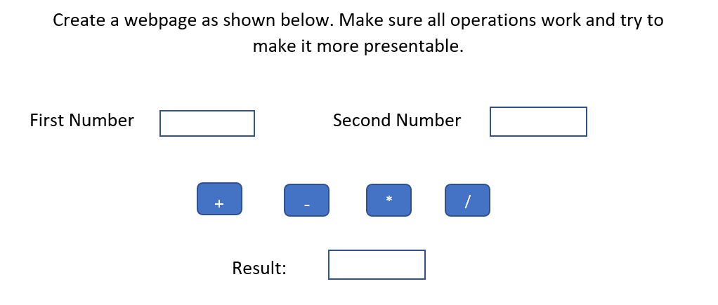

Slide 56
Quiz

Slide 57
Quiz
What is the output of below code?
let str = 'Hi’;
str[0] = 'h’;
alert( str[0] );

Slide 58
Quiz Ends

Slide 59
Thank you

